Slide 1
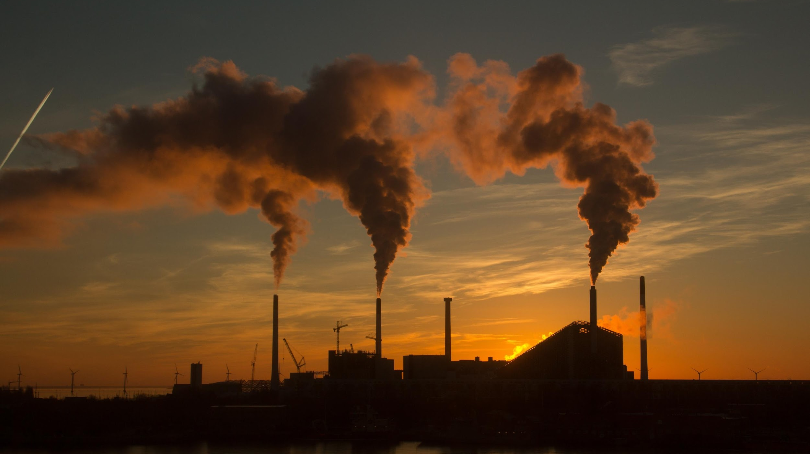

AIR QUALITY ASSESSMENT OF DELHI USING GIS
B.Tech Project
Presented By –
Aditya Kumar Jha 2K20/CE/18
Aditya Ranjan 2K20/CE/22
Deep Aryan Saini 2K20/CE/50
Under the Supervision Of :
Prof. T Vijay Kumar

Slide 2
OBJECTIVES
Temporal Analysis: To Analyze Pollutants data season-wise and examine variations in pollutant concentration across different seasons.
Spatial Analysis of Air Quality Parameters: Utilize GIS to map and analyze key air quality parameters, including particulate matter, nitrogen dioxide, sulfur dioxide, and ozone across Delhi.
Identification of Pollution Hotspots: Pinpoint areas with elevated pollutant concentrations to identify pollution hotspots.

Slide 3
METHODOLOGY
Data Collection:
Gathered air quality data from 39 monitoring stations in Delhi focusing on five key pollutants: SO2, Ozone, NOx, PM2.5, and PM10.
Acquired data for the time frame January 1, 2021 to December 31, 2022 from Central Pollution Control Board (CPCB) website.
Data Preprocessing:
Cleaned the obtained raw data using MS Excel by addressing the missing or inconsistent values.
Added Latitude and Longitude values for every monitoring station to make it compatible for use with the ArcGIS Tool.

Slide 4
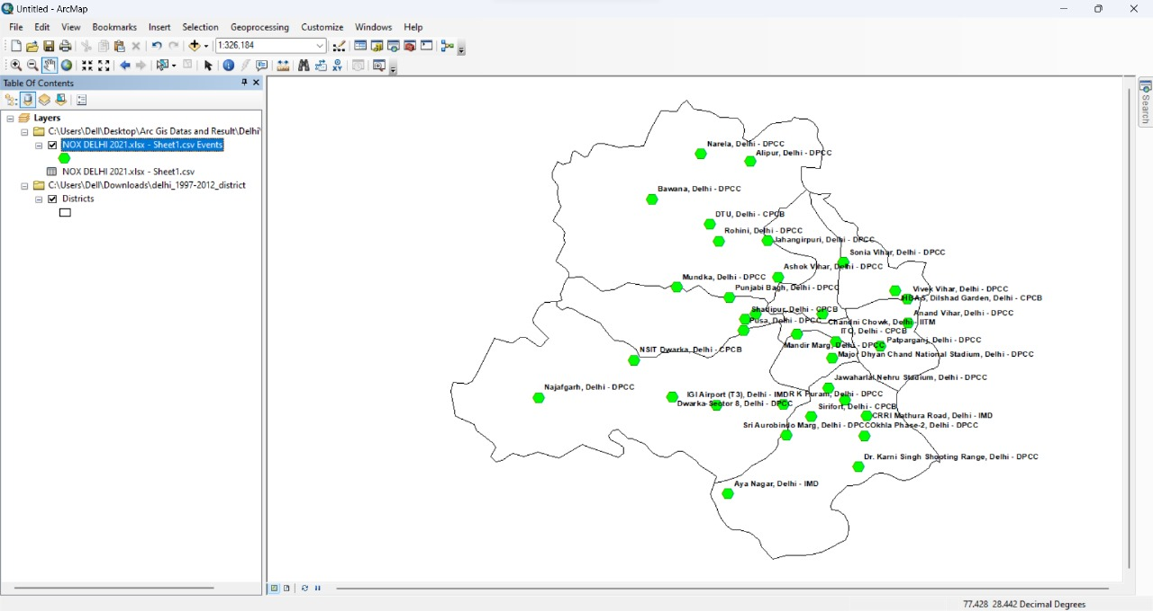

Slide 5
METHODOLOGY
Interpolation Techniques & Error Analysis:
Utilized advanced GIS techniques for spatial analysis which included the following interpolation methods - Inverse Distance Weighting (IDW), Kriging, Spline, and Natural Neighbor Interpolation.
Conducted a comprehensive error analysis afterwards to determine the accuracy of each technique.
Mapping and Visualizations:
Utilized ArcGIS software, for mapping spatial distributions and generated visually impactful maps to illustrate pollutant concentrations across Delhi.

Slide 6
RESULTS
Seasonal Variation Analysis Table
Pollutants | Pre-Monsoon | Monsoon | Post Monsoon | Winter | Std. Dev | Annual Avg
SO2 | 20.07 | 5.1 | 10.3 | 9.97 | 6.27 | 11.36
NOX | 21.92 | 8.96 | 32.39 | 36.92 | 12.42 | 25.04
PM10 | 265.55 | 82.26 | 277.98 | 288.29 | 97.94 | 228.52
PM2.5 | 90.4 | 33.76 | 160.54 | 190.83 | 70.63 | 118.88
OZONE | 24.72 | 15.43 | 48.22 | 31.08 | 13.82 | 29.86
Above table Depicts the different Values of Pollution Levels across different seasons along with the Annual average and Standard Deviation values.

Slide 7
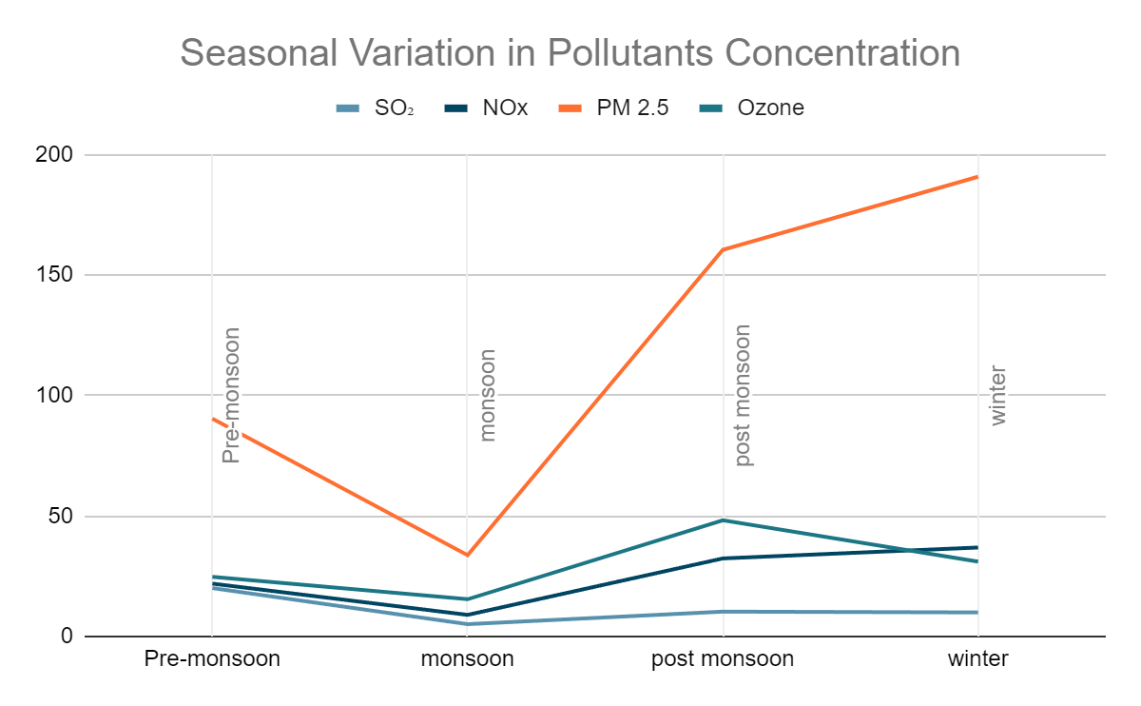
RESULTS

Slide 8
RESULTS
Pollutant | Interpolation Technique having least Error
NO_{x} Gas | Kriging ( 4.09% Error )
OZONE Gas | IDW ( 27.18% Error)
SO₂ Gas | Kriging ( 33.15% Error )
PM 10 | Kriging ( 14.42% Error )
PM 2.5 | IDW ( 11.27% Error )

Slide 9
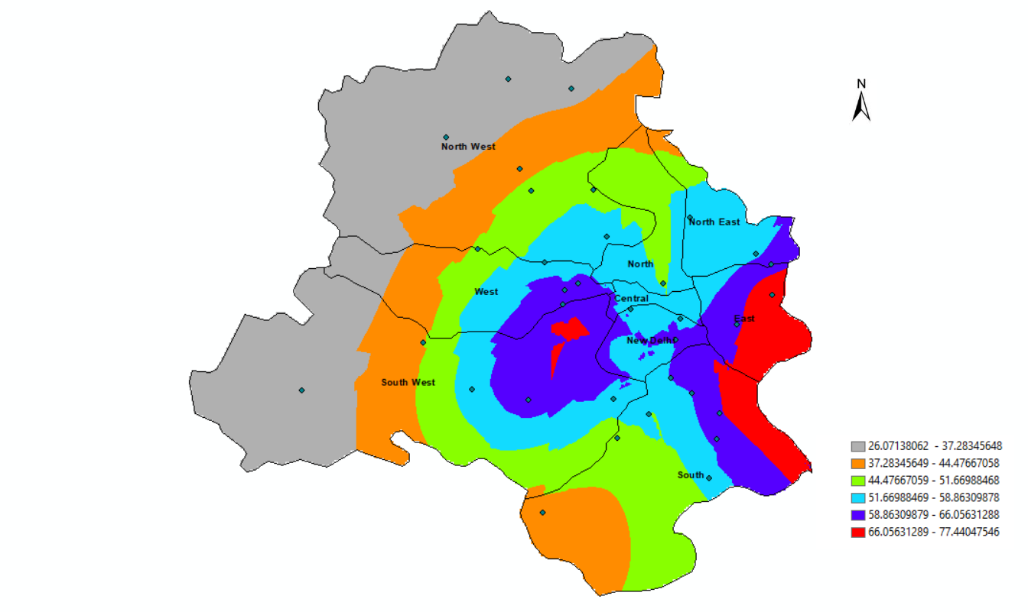
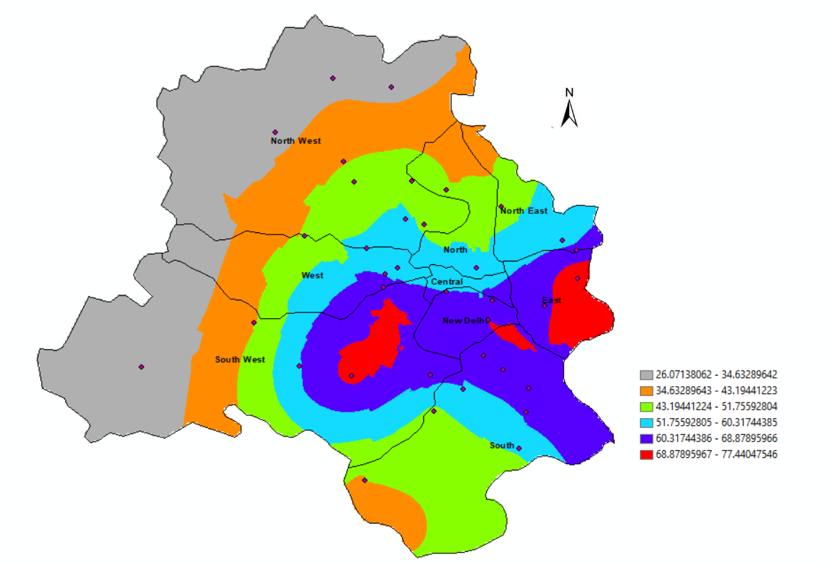
RESULTS : MAPPING
NOx DELHI 2021
NOx DELHI 2022
Above GIS maps show NOx hotspots in Delhi (2021-2022). Mainly in East Delhi borders and parts of South West Delhi near Pusa area.

Slide 10
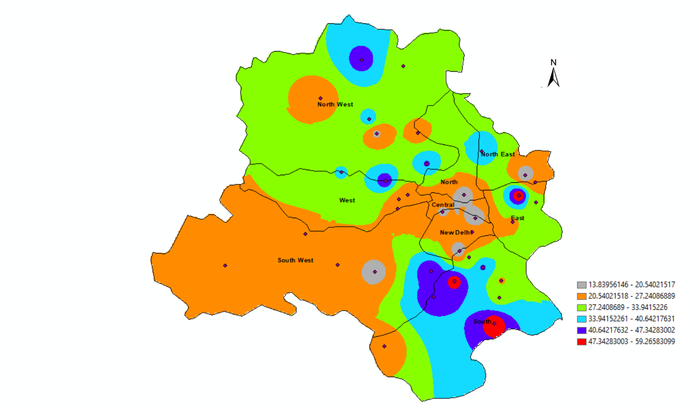
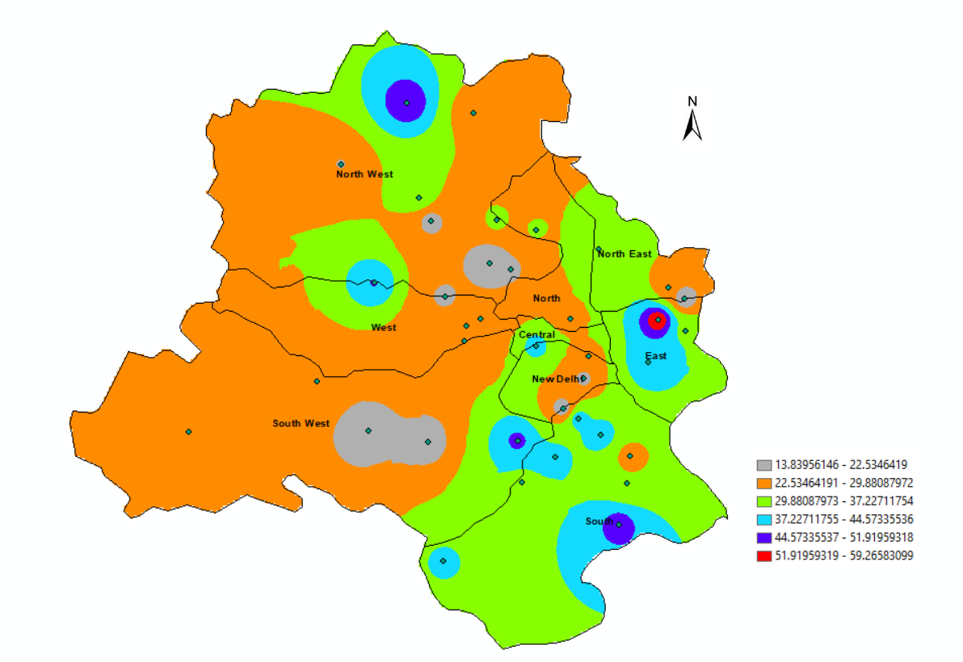
OZONE DELHI 2021
OZONE DELHI 2022
Above GIS maps reveal high Ozone concentration in Delhi (2021-2022), especially in East and South Delhi, mainly concentrated near East Arjun Nagar.

Slide 11
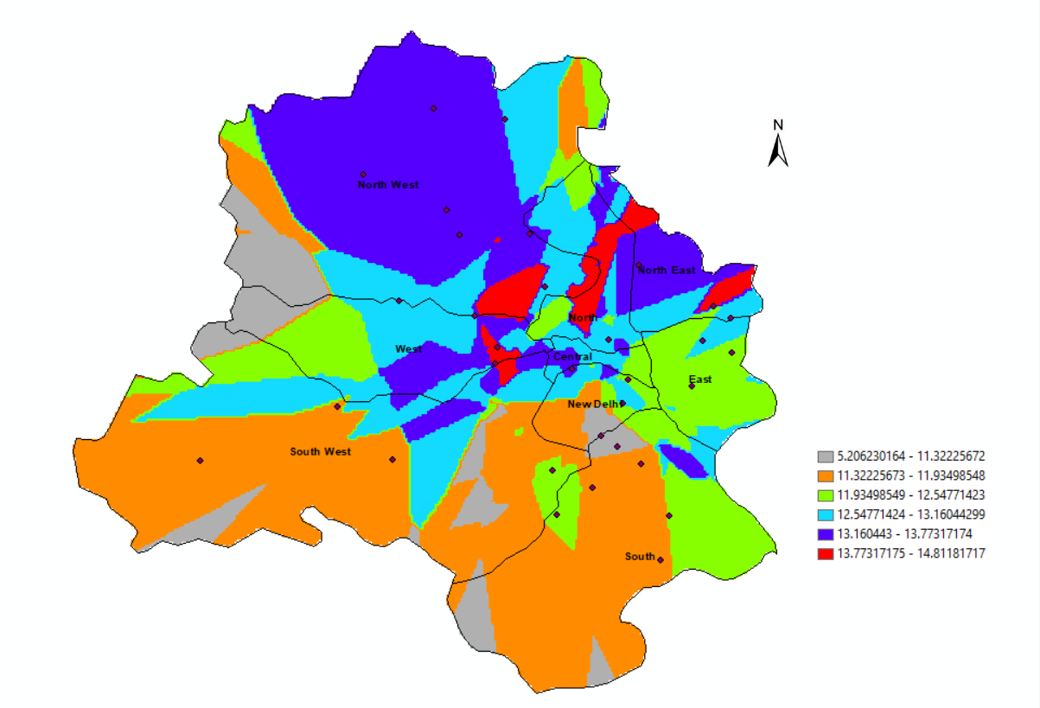
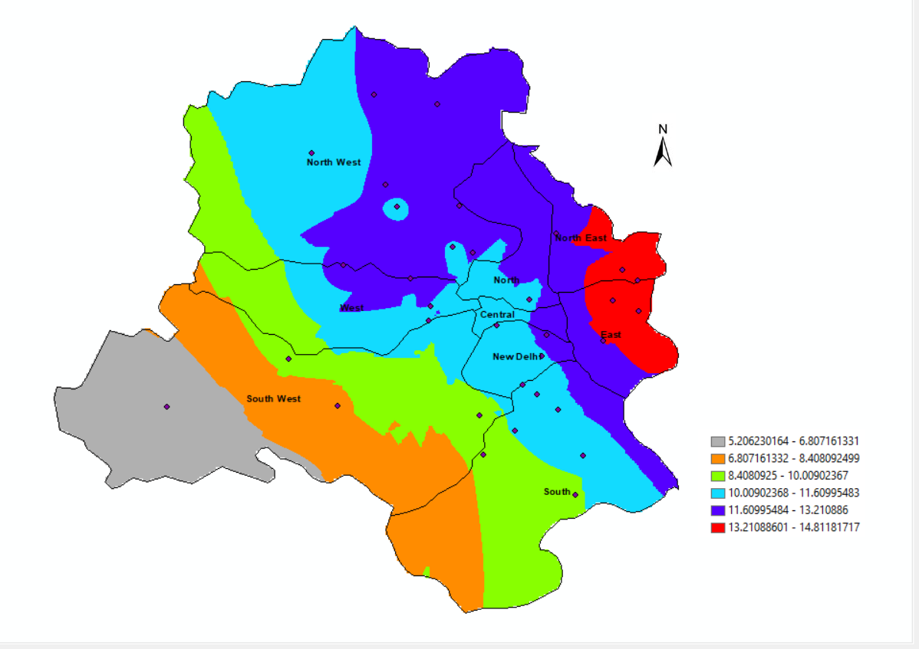
SO2 DELHI 2021
SO2 DELHI 2022
GIS maps indicate significant SO2 concentration in Delhi (2021-2022), with major hotspots in North East and East Delhi, especially near East Arjun Nagar.

Slide 12
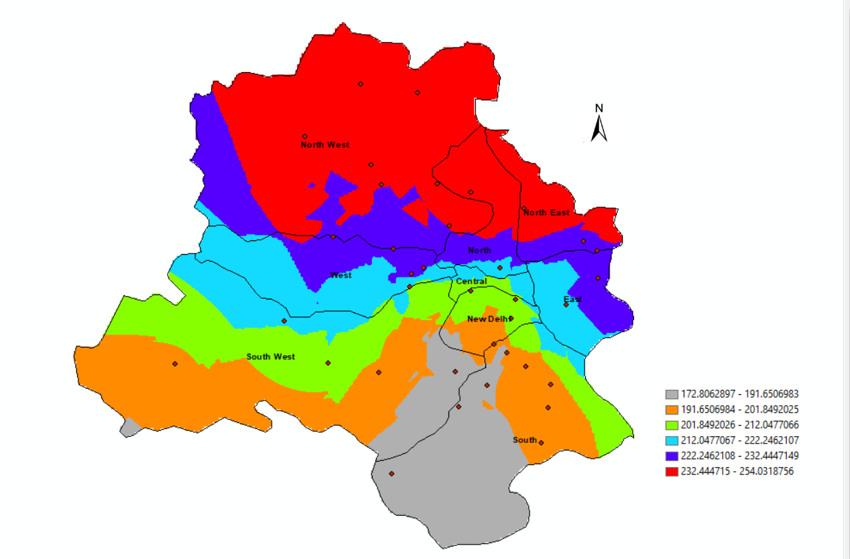
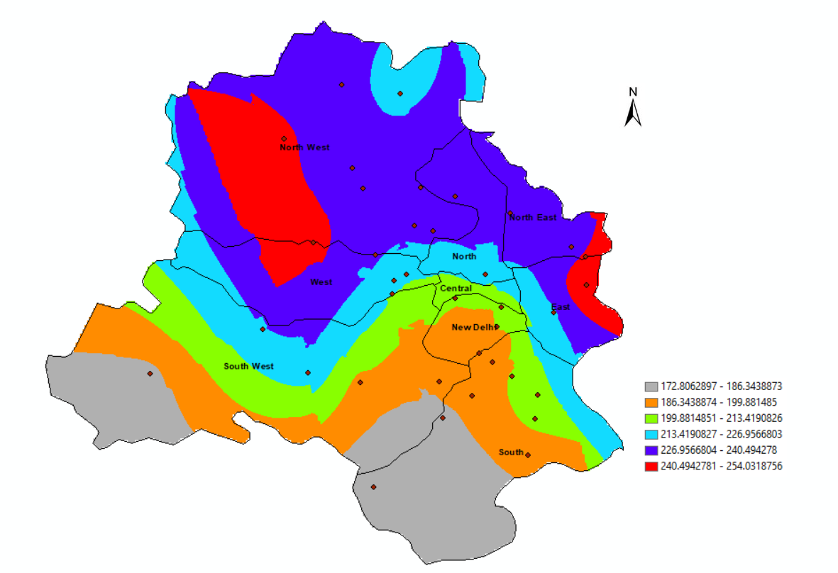
PM 10 DELHI 2021
PM 10 DELHI 2022
GIS maps highlight major PM10 hotspots in Delhi (2021-2022), particularly in the Northwest near Bawana and parts of Northeast and East near Anand Vihar.

Slide 13
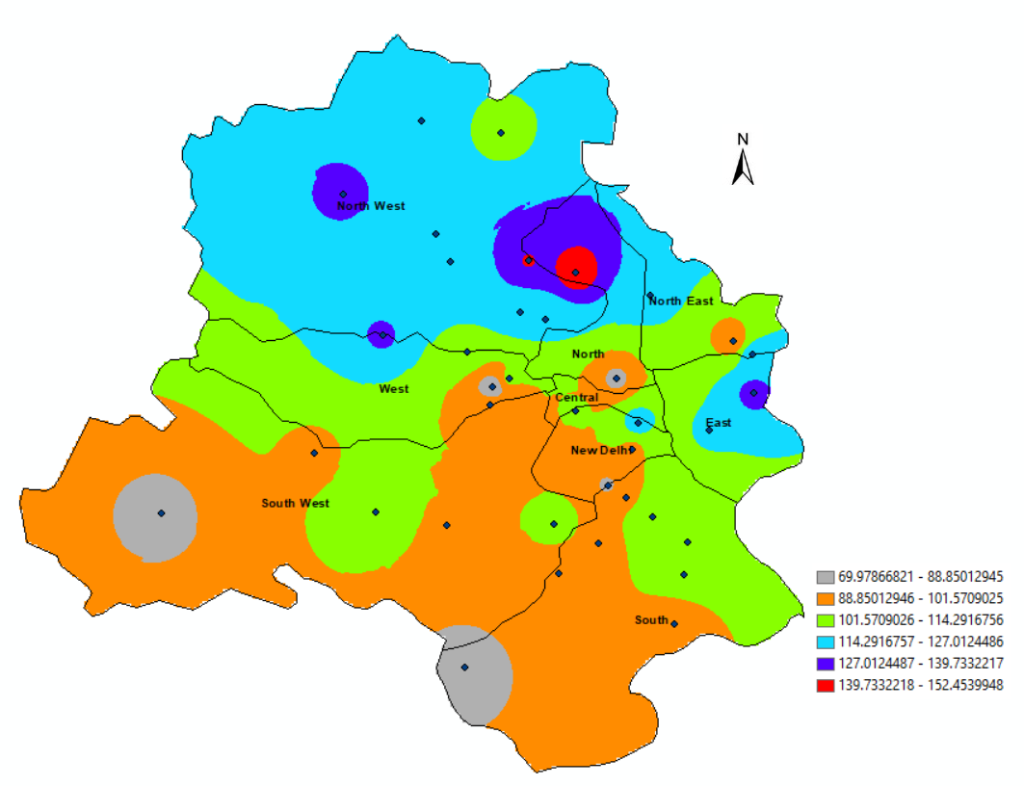
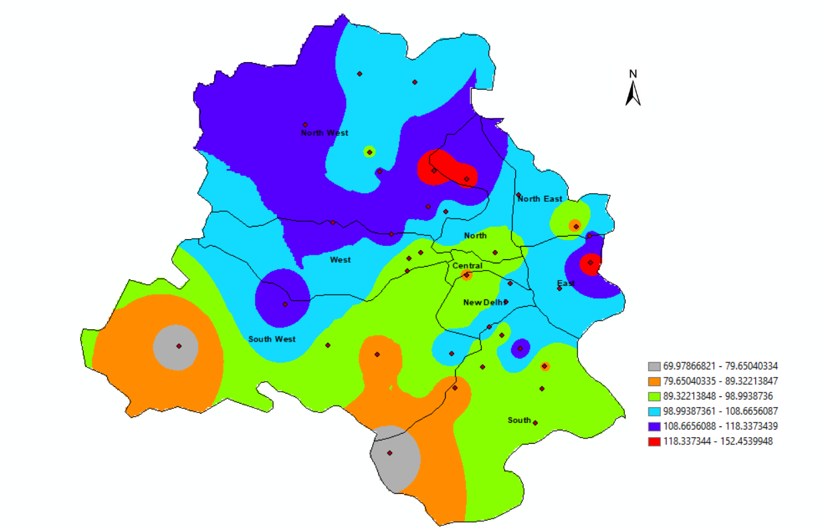
PM 2.5 DELHI 2021
PM 2.5 DELHI 2022
GIS maps indicate elevated PM2.5 concentrations in Delhi (2021-2022), notably in North and North-West Delhi, East Delhi (Anand Vihar region), and near Burari Crossing.

Slide 14
CONCLUSION
Through Temporal Seasonal Analysis we came to a conclusion that Delhi is the most polluted in Post Monsoon Season and Winter Season and least polluted in Monsoon season.
As we did Error Analysis, from there we concluded that Kriging and IDW techniques gave the least error or accurate desired result. Kriging performed best among all the interpolation techniques which we used.

Slide 15
CONCLUSION
From the GIS Maps that we made we came to a conclusion that major concentration of pollutants are in North west part of Delhi near Delhi Haryana borders and in some parts of East Delhi regions .
DATA AND RESULT DRIVE LINK- LINK

Slide 16


